Slide 1



CAR RENTAL SYSTEM
June 24, 20XX – July 7, 20XX
June 24, 20XX – July 7, 20XX
AMALA ROSE SEBASTIAN
22PMC109

Slide 2

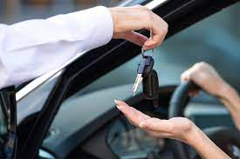
JOURNEY
Abstract
Requirements
Features and highlights
Technical aspects
Challenges
Screenshots
Future enhancements
Conclusion
references
our

Slide 3

ABSTRACT
This project is designed so as to be used by Car Rental Company specializing in renting cars to customers. It is an online system through which customers can view available cars, register, view profile and book car. Online Car Rental System project is designed to aid the car rental company to enable renting of cars through an online system. It helps the users to search for available cars view profile and book the cars for the time period. It has a user-friendly interface which helps the user to check for cars and rent them for the period specified.

Slide 4
Car rental system is divided into two modules: User Module Admin Module User Module details: View and book Available Cars View car Booking details Give query Admin Module details: Dashboard Manage Vehicle brand Manage Vehicle Manage Bookings Manage query View Registered users
REQUIREMENTS

Slide 5
Easy Booking Recommendations and User Feedback Communication and Updates Reservations Management The new system is totally computerized system. A new system provides features like time efficiency to show car details, user profiles and whatever the customer will give the feedback to the admin An inquiry is easily done by user in the system Enhance Business Processes
FEATURES

Slide 6
Presentation Layer Application Layer Business Logic Layer Jazmin Data Access Layer
TECHNICAL ASPECTS
ARCHITECTURE OF PROJECT

Slide 7
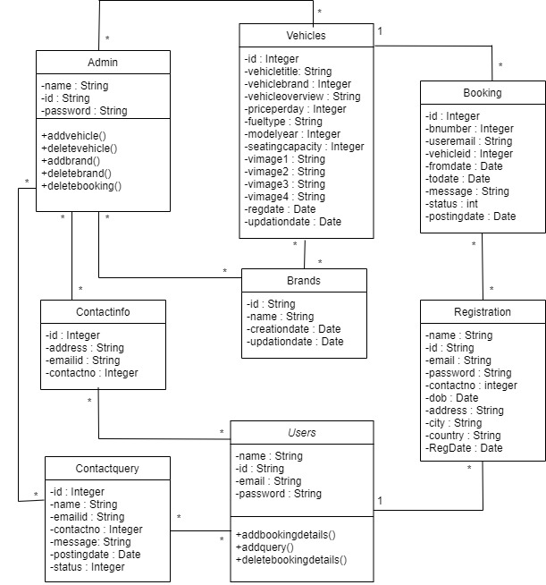
CLASS DIAGRAM

Slide 8
User Experience and Design Real-time Availability and Pricing User Authentication and Authorization Validation Mechanisms Database Management
CHALLENGES

Slide 9
SCREENSHOTS

Slide 10
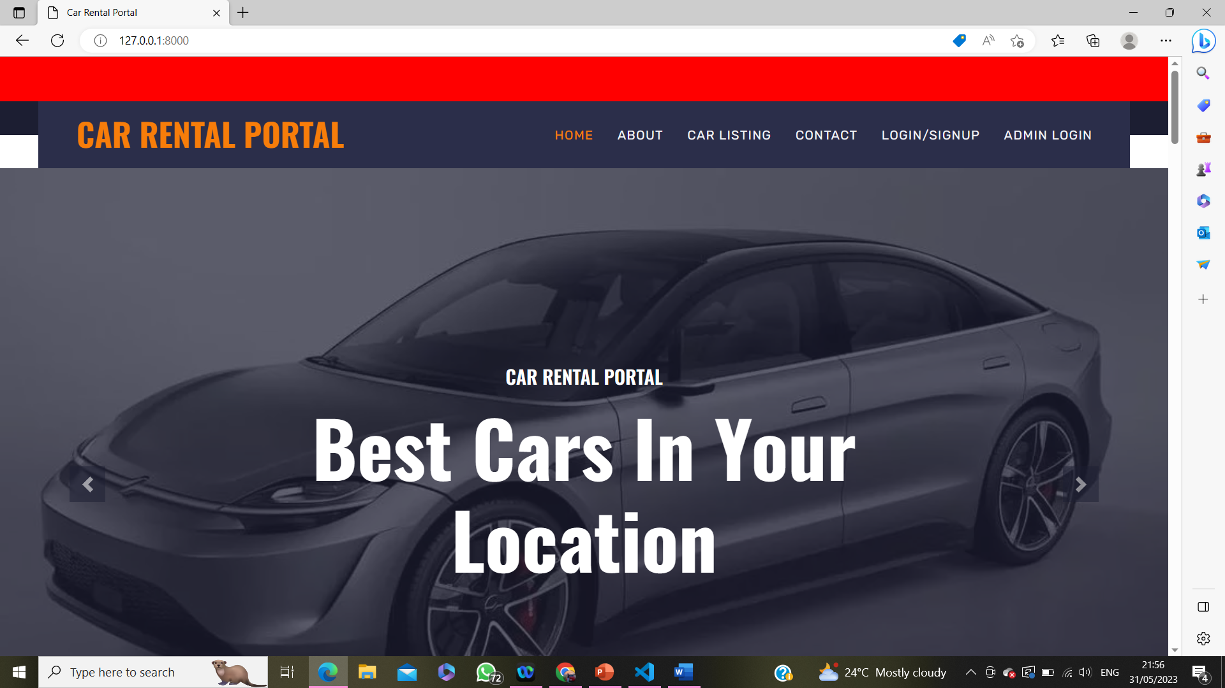
HOME PAGE

Slide 11
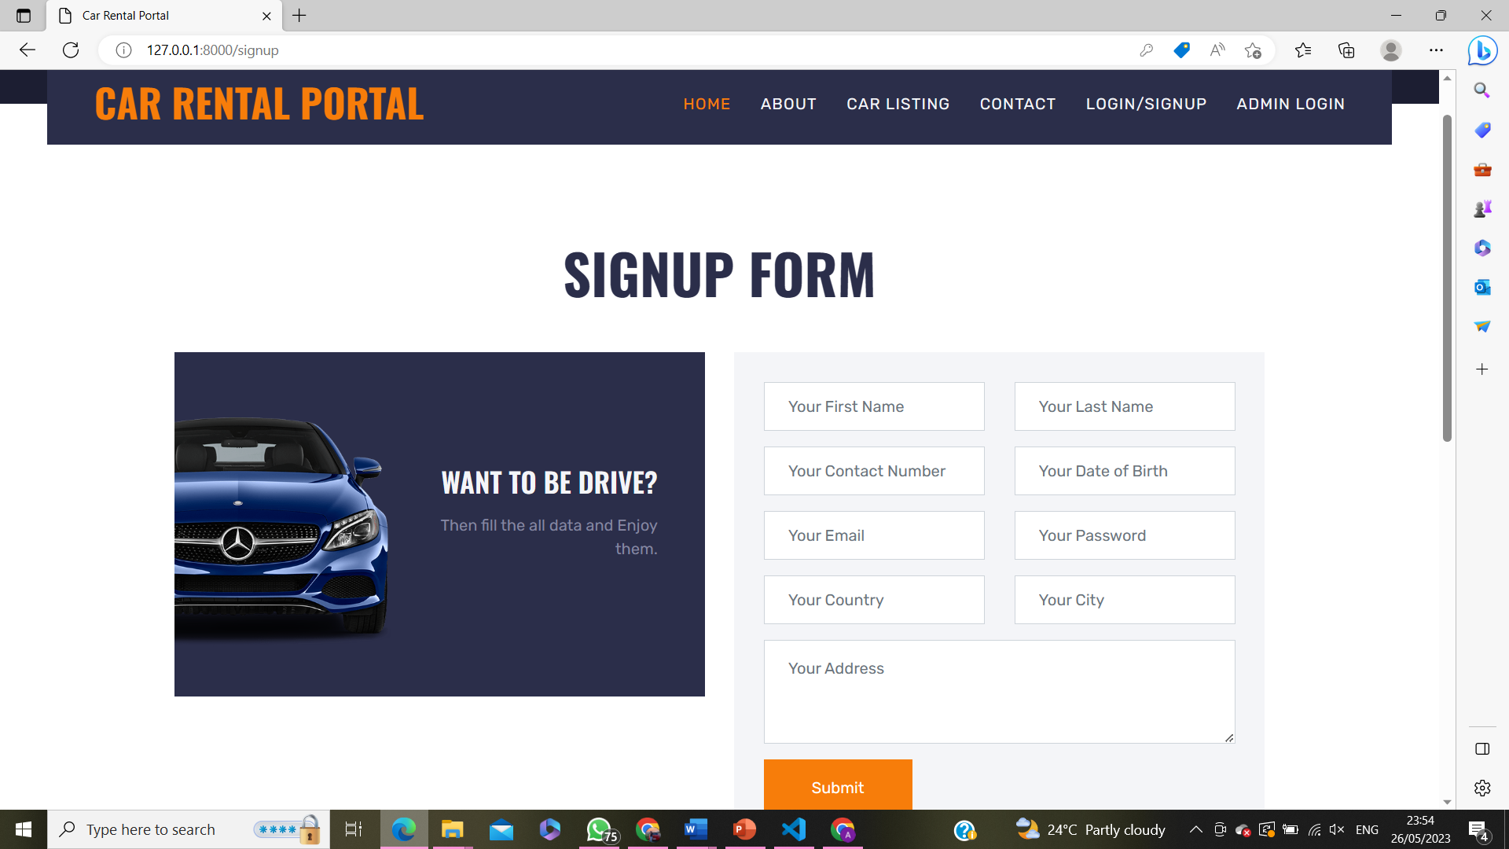
REGISTRATION

Slide 12
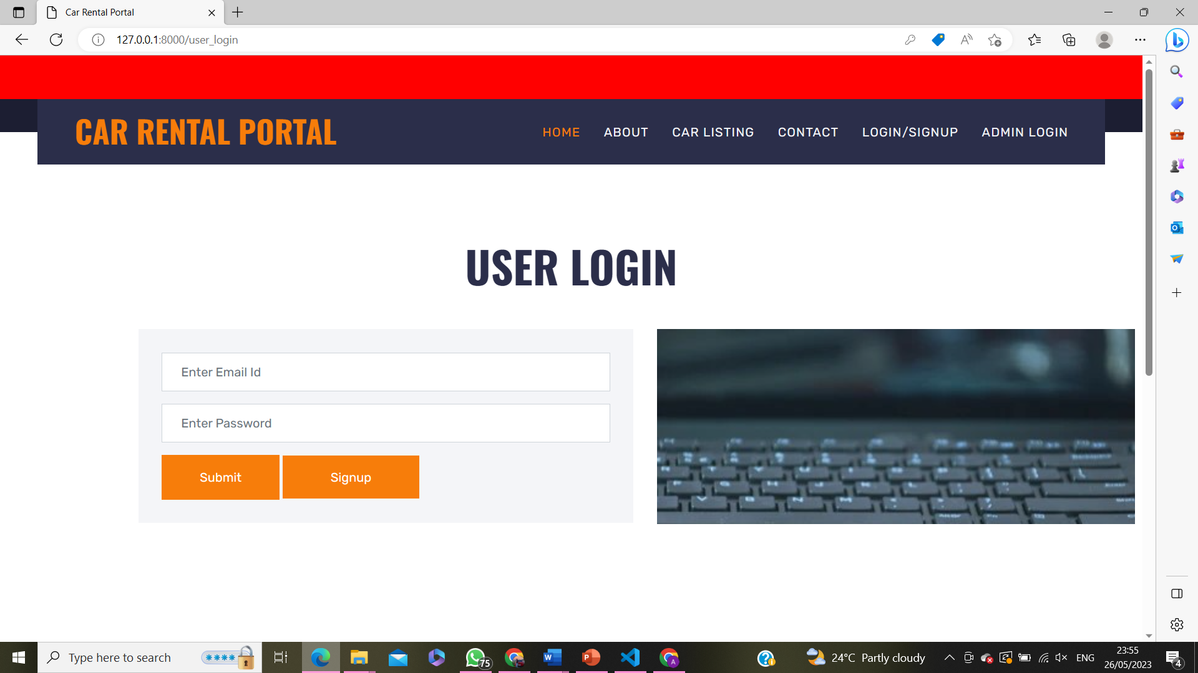
USER LOGIN

Slide 13
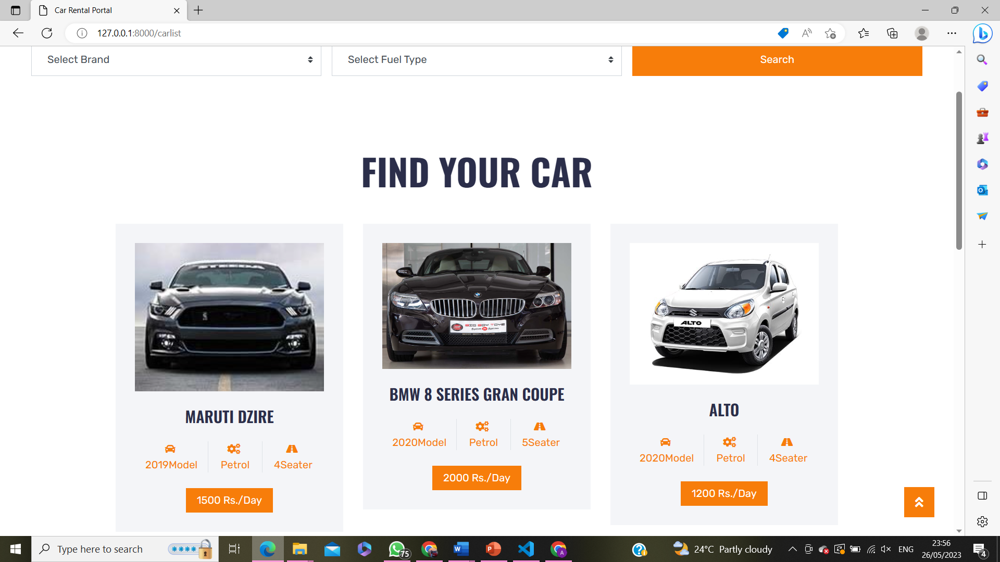
CAR LISTING

Slide 14
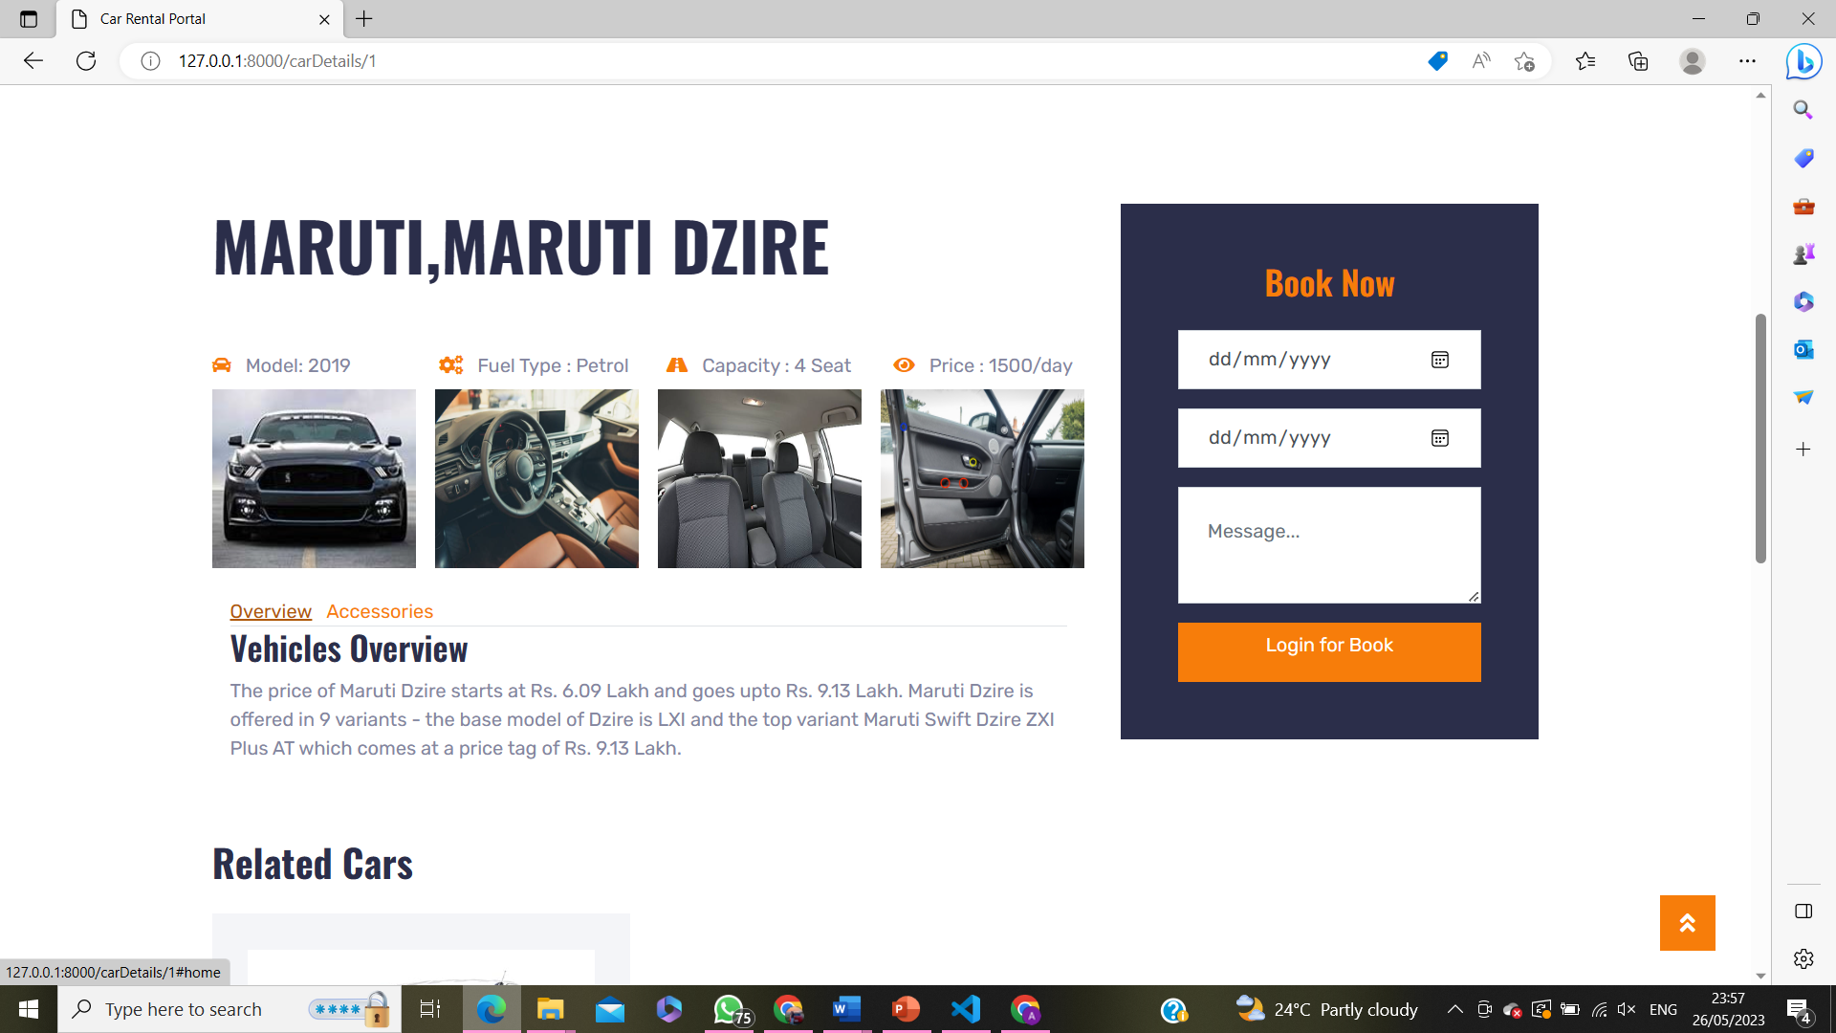
CAR DETAIL

Slide 15
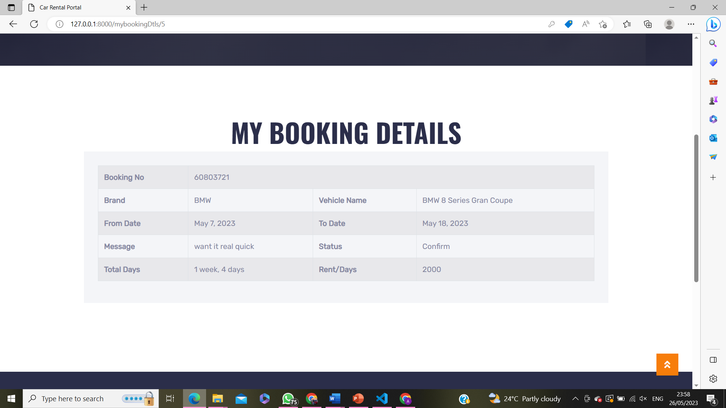
BOOKINGS PAGE

Slide 16

ADMIN LOGIN

Slide 17
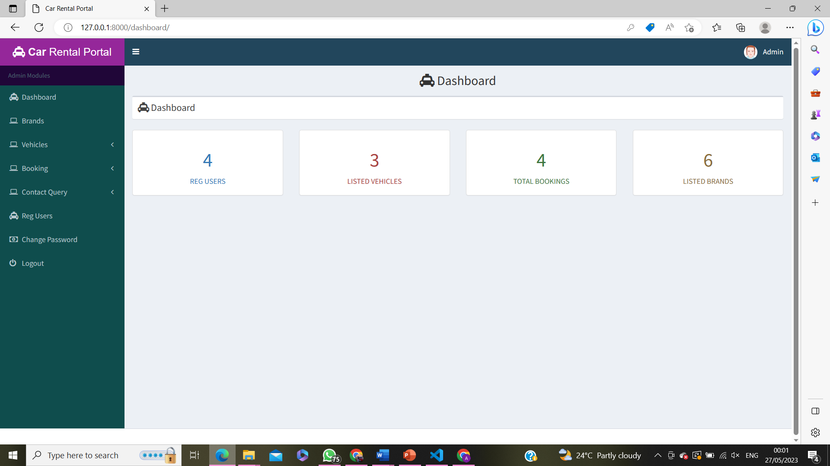
ADMIN HOMEPAGE

Slide 18
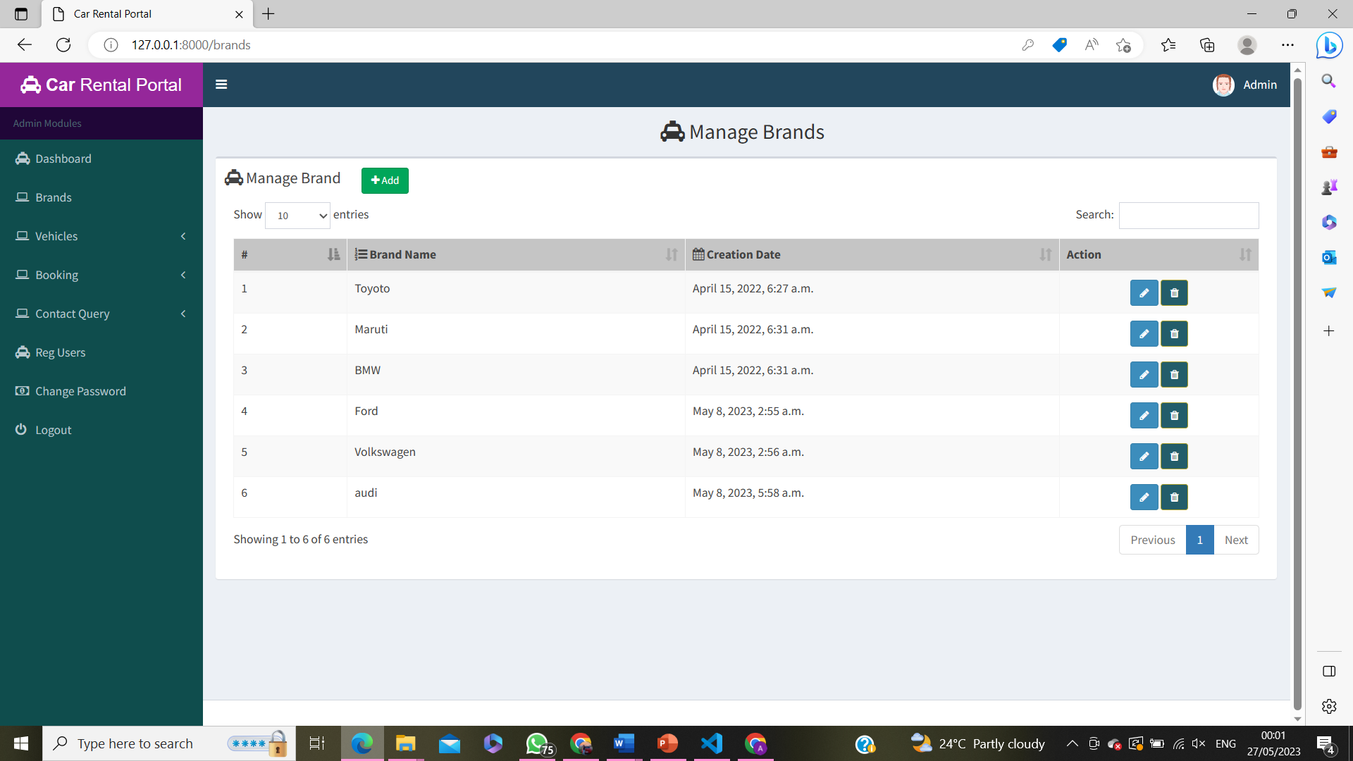
BRANDS

Slide 19
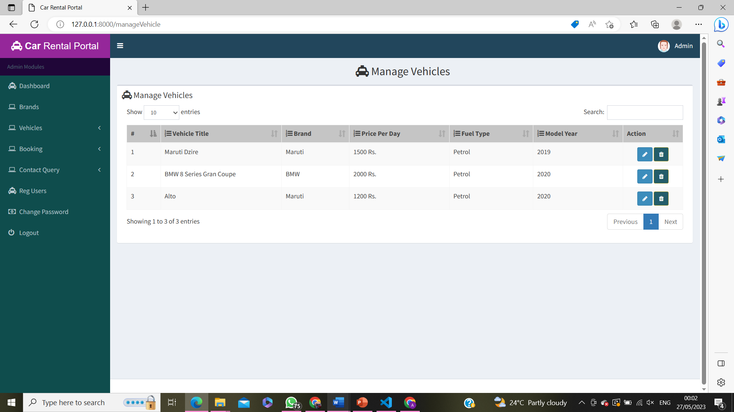
VEHICLES

Slide 20
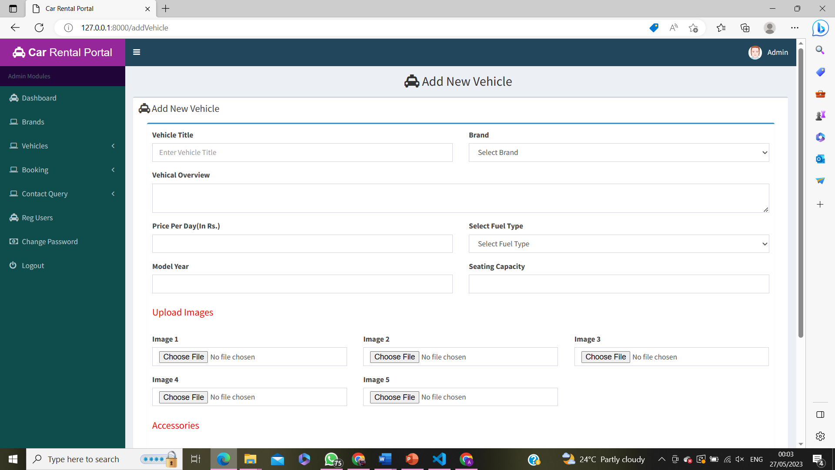
ADD VEHICLE

Slide 21
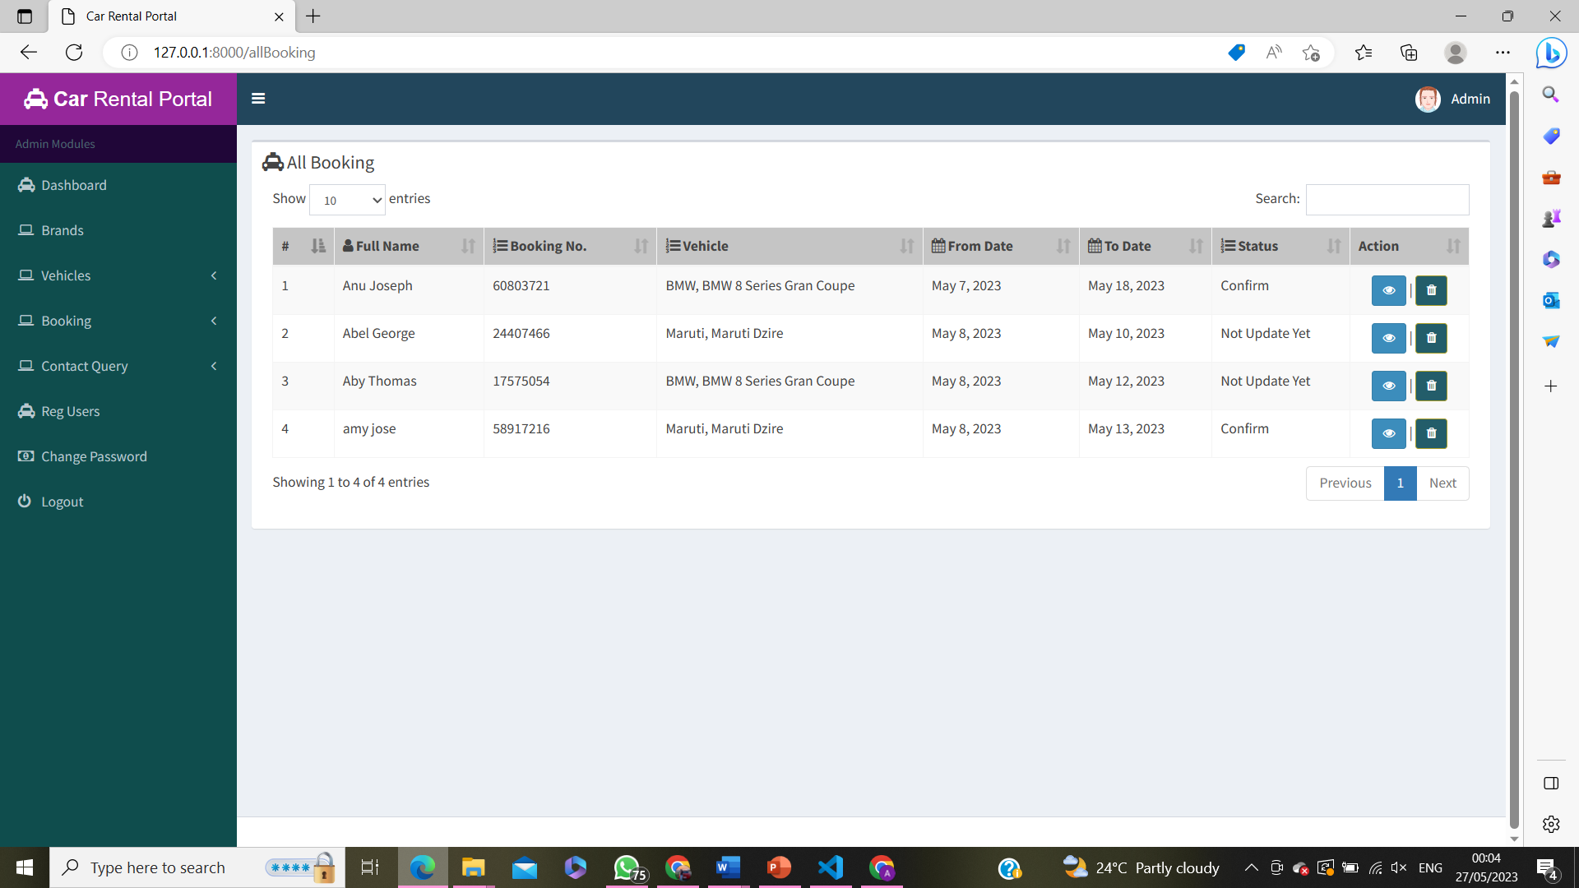
VIEW BOOKING

Slide 22
Quick and Secure Payments Social Media Integration Location-based Rentals Report Generation
FUTURE ENHANCEMENTS

Slide 23

CONCLUSION
This project is designed so as to be used by Car Rental Company specializing in renting cars to customers. It is an online system through which customers can view available cars, register, view profile and book car. Online Car Rental System project is designed to aid the car rental company to enable renting of cars through an online system. It helps the users to search for available cars view profile and book the cars for the time period. It has a user-friendly interface which helps the user to check for cars and rent them for the period specified.

Slide 24
https://docs.djangoproject.com/en/4.1/intro/tutorial01/ https://www.planyo.com/car-rental-reservation-system.php getbootstrap.com
REFERENCES

Slide 25

THANKYOU

